Slide 1
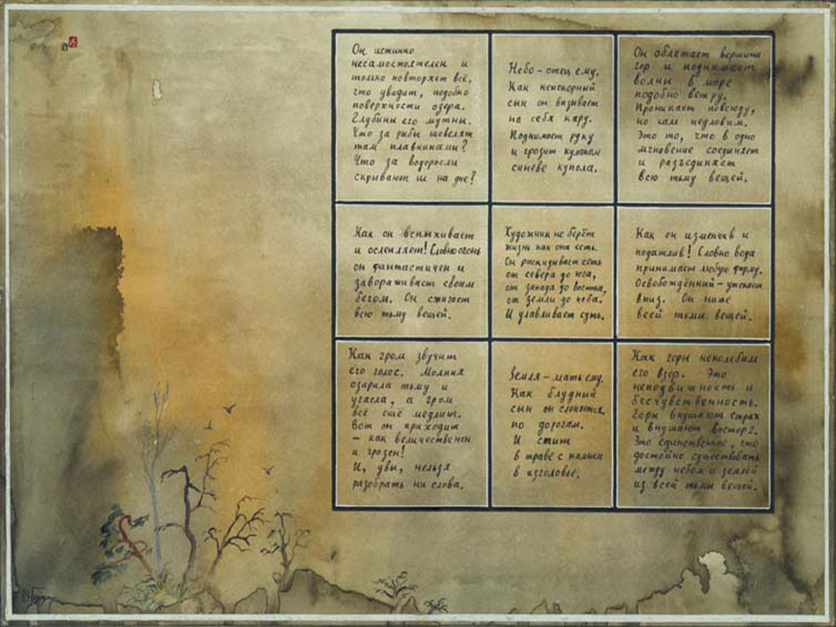
Igor Burdonov
Alexander Kossatchev
Parallel Calculations by Automata on dynamically changing graph
The Institute for System Programming (ISP) of the Russian Academy of Sciences (RAS)

Slide 2
Problem Statement
Compute some function of values stored in vertices of a graph
Use parallelism
Given directed graph G = <V, E>, f : V → A
Compute function F of multiset of f values F(f<V>)
Example
Summarize notes on car brands on BBC site f : [page] → ([brand] → [number]) need to compute some F(multiset of maps)


(34)
I.Burdonov, A.Kossatchev. ISP RAS. Parallel Calculations by Automata on dynamically changing graph

Slide 3
Aggregate Functions
X – base set, X# - all finite multisets of X elements
Function g : X# → A is aggregate ≡ ∃e : A×A → A ∀a,b∈X# g(a∪b) = e(g(a),g(b))
Σ : {a₁,…a_{n}} ↦ Σ_{i=1..n}a_{i} [e = +]
min : {a₁,…a_{n}} ↦ min_{i=1..n}(a_{i}) [e = min]
Q : {a₁,…a_{n}} ↦ Σ_{i=1..n}a_{i}² [e = +]
For an aggregate function ∀r∈ℕ ∃e_{r} : A^{r} → A ∀a₁,…,a_{r}∈ X# g(U_{i=1..r}a_{i}) = e_{r}(g(a₁),…,g(a_{r}))
Criterion g : X# → A is aggregate ⇔ ∀x∈X a,b∈X# g(a)=g(b) ⇒ g(a∪{x}) = g(b∪{x})
EXAMPLES



(34)
I.Burdonov, A.Kossatchev. ISP RAS. Parallel Calculations by Automata on dynamically changing graph

Slide 4
Aggregate Extension
For a function F : X# → A aggregate function g : X# → B is aggregate extension ≡ ∃h:B→A F = hg
g : X# → B is minimal aggregate extension ≡ g(X#) = B & ∀g`: X# → B` [g` is aggregate extension of F ⇒ ∃j : B`→B g = jg`]
Minimal aggregate extension always exists and is unique up to isomorphism
F : {a₁,…,a_{n}} ↦ (Σ_{i=1..n}a_{i})/n arithmetic mean g : {a₁,…,a_{n}} ↦ <Σ_{i=1..n}a_{i}, n> h : <a, b> ↦ (a/b) F : {a₁,…,a_{n}} ↦ (Π_{i=1..n}a_{i})^(1/n) geometric mean g : {a₁,…,a_{n}} ↦ <Π_{i=1..n}a_{i}, n> h : <a, b> ↦ (a^(1/b)) F : {a₁,…,a_{n}} ↦ ((Σ_{i=1..n}a_{i}²)/n)^(1/2) quadratic mean g : {a₁,…,a_{n}} ↦ <Σ_{i=1..n}a_{i}², n> h : <a, b> ↦ ((a/b)^(1/2))
EXAMPLES


(34)
I.Burdonov, A.Kossatchev. ISP RAS. Parallel Calculations by Automata on dynamically changing graph

Slide 5
Main Ideas
graph
G
Given directed graph G = <V, E>, f : V → A
Compute function F of multiset of f values F(f<V>)
To compute F(f<V>)
represent F as hg, where g is aggregate
compute g in parallel
in the end compute F
One of vertices is distinguished and called the root.
The root receives from outside the message - query with parameters: h, g, e.
After calculation the root sends outside the message - response with parameter F(f<V>) = hg(f<V>).
root
h,g,e
hg(f<V>)




(34)
I.Burdonov, A.Kossatchev. ISP RAS. Parallel Calculations by Automata on dynamically changing graph

Slide 6
Main Ideas
Marking algorithm:
The structure on the graph is created by means of marks in vertices.
Pulse algorithm:
Using the created structure, function F is calculated.
I.Burdonov, A.Kossatchev. ISP RAS. Parallel Calculations by Automata on dynamically changing graph
(34)

Slide 7
Marking algorithm
I. B. Bourdonov, A. S. Kossatchev, V. V. Kuliamin.
Parallel Computations on a Graph.
Programming and Computer Software, 41(1), 2015
Building direct and back spanning trees by automata on a graph.
Parallel calculations by automata on direct and back spanning trees of a graph.
French-Russian Seminar on Software Verification, Testing, and Quality Estimation, Paris, France, November 34-25, 2014
The structure on the graph :
direct spanning tree
back spanning tree
in each vertex: the number of incoming back arcs (maybe 0)
I.Burdonov, A.Kossatchev. ISP RAS. Parallel Calculations by Automata on dynamically changing graph
(34)

Slide 8
Pulse Algorithm
Root
obtains g, h, e: g(a∪b) = e(g(a),g(b)), F = hg
sends Query message with <g, e> along direct arcs
Each vertex v
saves e and X = g(f(v))
(if [direct arcs number] > 0) after getting Query re-sends it along direct arcs, set [responses] = [back arcs number]
(if [back arcs number] = 0) after getting Query sends g(f(v)) with Response message along back arc
(if [back arcs number] > 0 and [responses] > 1) after getting Response message with value Y, save X = e(X, Y), decrease [responses]
(if [back arcs number] > 0 and [responses] = 1) after getting Response message with value Y
(not root) sends X = e(X, Y) with Response message along back arc
(root) compute and return F(f<V>) = h(e(X, Y))
Number of operations is O(D)

(34)
I.Burdonov, A.Kossatchev. ISP RAS. Parallel Calculations by Automata on dynamically changing graph

Slide 9
Example
Computing arithmetic mean of values in graph vertices
direct spanning tree
Back spanning tree
the number of incoming back arcs
F(x₁,x₂,…,x_{k}) = (x₁+x₂+…+x_{k})/k
g(x) = (x,1)
e((x,a),(y,b)) = (x+y,a+b)
h(x,a) = x/a
root
2
<.+., n>, ./.
0
65/13 = 5
22, 4
5, 1
1
0
2
1
0
5
6
9
31, 5
9, 1
13, 2
65, 13
6, 1
0
0
7, 1
0
7
0
4, 1
4
2
0
1
4
5
5, 1
2, 1
0
4, 1
9, 2
1

0
0
1
1
8

1, 1
9
query
2
0

10, 2
3
8, 1

10, 2
9, 1
0
2

1

response
3
34, 8
2, 1

11, 3

13, 3
3, 1




(34)
I.Burdonov, A.Kossatchev. ISP RAS. Parallel Calculations by Automata on dynamically changing graph

Slide 10
Dynamically changing graph Identification of vertices and numbering of arcs
n – number of vertices, m – number of arcs.
Each vertex has unique vertex identifier.
Automaton obtains identifier of the vertex where it places by primitive “Get identifier”.
All arcs outgoing from the vertex are enumerated: 1, 2, 3…
Unique arc identifier is a couple (identifier of the arc head, arc number).
The number of such couples are equal to m.
I.Burdonov, A.Kossatchev. ISP RAS. Monitoring of dynamically changing graph. REMINDER
(34)

Slide 11
Dynamically changing graph Message transmission
[Automaton at] the arc head sends a message by means of the primitive “Send” with parameters “message” and “arc number”.
Only one message can be transmitted simultaneously on the arc.
When a message is transmitting the arc is busy otherwise it’s free.
The arc becomes free when the message is obtained by the [automaton at the] arc tail. At this moment the signal “Arc clearing” is generated (parameter: arc number).
I.Burdonov, A.Kossatchev. ISP RAS. Monitoring of dynamically changing graph. REMINDER
(34)

Slide 12
Dynamically changing graph Graph changing
Only arcs can be changed, the vertex are permanent.
The appearance of the arc. A signal of arc appearance is generated.
Disappearance of the arc. If on an arc the message was transferred it is lost , and the signal of disappearance of an arc is generated.
Change of an arc tail. Any signals it is not generated. If the message was transferred on an arc , it continues to be transferred on an arc, but will get in a new arc tail.
The automaton at the arc head receives the signal. Parameter of the signal: arc number.
"Long-living" arc – at least 1 tick doesn’t change.
The ASSUMPTION: During each moment of time "long-living" arcs generated strongly connected spanning subgraph.


I.Burdonov, A.Kossatchev. ISP RAS. Monitoring of dynamically changing graph. REMINDER
(34)

Slide 13
Dynamically changing graph Automaton queue of input symbols
Input symbols of the automaton: signals from outgoing arcs and messages on ingoing arcs. Queue of input symbols.
The queue can contain no more than one signal for each outgoing arc.
Why? Because, if the signal is generated, when the previous signal for the same arc isn’t dequeued, the new signal replaces itself an old signal. Such new signal can be only a signal of arc appearance.
Scheme of signal replacement:
Clearing, then appearance → appearance
Disappearance, then appearance → appearance
Appearance, then appearance → appearance



I.Burdonov, A.Kossatchev. ISP RAS. Monitoring of dynamically changing graph. REMINDER
(34)

Slide 14
Dynamically changing graph Automaton queue of input symbols
Input symbols of the automaton: signals from outgoing arcs and messages on ingoing arcs. Queue of input symbols.
The queue can contain no more than one signal for each outgoing arc.
The queue can contain no more than one message for each ingoing arc.
Why? Because the signal of clearing of an arc is generated not when the message has reached an arc tail and is put in queue but when the automaton dequeues this message.
The length of queue does is at most the degree of vertex, i.e. it is at most 2m (the loop is considered 2 times).


I.Burdonov, A.Kossatchev. ISP RAS. Monitoring of dynamically changing graph. REMINDER
(34)

Slide 15
Dynamically changing graph
If graphs dynamically changes, then the trees should change dynamically.
PROBLEM: Change of an arc of a tree, generally,
should lead to reorganization of whole tree.
The DECISION: the Virtual tree: instead of arc A→B pair vertices (A, B).
At distribution of the message by "fan", as in the case of the monitoring, the message will be transferred from A to B, only not on an arc, but on any path (a route without self-crossing).
Transfer of the message on real arc - O (1) ticks,
Transfer of the message on a virtual arc - O (n) ticks.
Transfer of the message on a real tree of height h - O (h) ticks,
Transfer of the message on a virtual tree - O (nh) ticks.





I.Burdonov, A.Kossatchev. ISP RAS. Parallel Calculations by Automata on dynamically changing graph
(34)

Slide 16
Distribution of the message
To provide guaranteed distribution of a question and answers in dynamically changing graph, it is necessary:
The message sent by vertex, should contain a question and all answers received by these vertex.
Such message should be sent on each outgoing arc permanently.
I.Burdonov, A.Kossatchev. ISP RAS. Parallel Calculations by Automata on dynamically changing graph
(34)

Slide 17
Query
For distribution of a question
from a root to all vertices
the direct virtual tree is not necessary.
The message containing a question
will reach all vertices in time O (n) ticks.
I.Burdonov, A.Kossatchev. ISP RAS. Parallel Calculations by Automata on dynamically changing graph
(34)

Slide 18
Response
The back spanning virtual tree is not necessary, if the answer from vertex v
is 1) value of f(v) or 2) value of g(f(v)).
If the answer from v is f_{v}=f(v), that all calculations are performed in the root F(f<V>) = h(e_{n}(g(f₁), g(f₂),…, g(f_{n}))).
Value f (v) can be too great.
For example, f(v) is the database, to which vertex v has access.
If the answer from v is g_{v}=g(f(v)), that also all calculations are performed in the root F(f<V>) = h(e_{n}(g₁, g₂,…, g_{n})).
The message can contain g_{v} from each vertex v (except for the root), i.e. up to n-1 values of function g.
The back tree allows to reduce the number of values g_{v} in the message. It will be no more w - numbers of terminal vertices, as the message contains no more than one value g_{v} for each branch of the back tree (from terminal vertex up to a root).
I.Burdonov, A.Kossatchev. ISP RAS. Parallel Calculations by Automata on dynamically changing graph
(34)

Slide 19
Virtual back spanning tree
w - numbers of terminal vertices. It determines the size of the message.
h - height of a tree. It determines an operating time.
n ≤ hw+1.
QUESTION: When is h minimal at given w?
The ANSWER: When the tree looks like balanced “broom”.
n-1-w(h-1) branches
of height h
wh-n+1 branches
of height h-1
terminal vertex
inner vertex
…………………………………..
h = ](n-1)/w[
root
…….
…….

1
2
w



I.Burdonov, A.Kossatchev. ISP RAS. Parallel Calculations by Automata on dynamically changing graph
(34)

Slide 20
Marking algorithm
The structure on the graph:
direct spanning tree
back spanning tree
in each vertex: the number of incoming back arcs
- balanced “broom”
in the terminal vertex - 0
in the root - w
in the inner vertex - 1
The idea of algorithm:
The root collects information about all vertices.
The root builds a virtual back tree.
The marking of the graph: the message with the description of a back tree is sent from a root to all vertices.




(34)
I.Burdonov, A.Kossatchev. ISP RAS. Parallel Calculations by Automata on dynamically changing graph

Slide 21
1. Collection of information about all vertices
The automaton in vertex starts to work at receipt of the first message.
The root receives the first message "Start" from the outside after the initial moment of time t₀.
Initial arc is an arc, first time appearing at the moment of time t₀ and not changing until the first message will pass on the arc.
Sufficient condition of gathering of the information on vertices:
Initial arcs form a strongly connected spanning subgraph.



I.Burdonov, A.Kossatchev. ISP RAS. Parallel Calculations by Automata on dynamically changing graph
(34)

Slide 22
1. Collection of information about all vertices
For work of algorithm it is necessary "to know": whether the message sent on an arc has reached its tail or not.
The remark: For our algorithm it is enough "to know" only about, whether the first message sent on an arc after its first appearance has reached an arc tail.
PROBLEM: Automaton cannot learn, the message has reached or not.
The message has reached, the signal of clearing is generated. Before its processing the arc disappears (a signal of disappearance is not present, as on an arc there is no message), and then appears: the signal of appearance replaces a signal of clearing.
The message has not reached yet, and the arc disappears. The signal of disappearance of an arc is generated. Before its processing the arc appears: the signal of appearance replaces itself a signal of disappearance.


I.Burdonov, A.Kossatchev. ISP RAS. Parallel Calculations by Automata on dynamically changing graph
(34)

Slide 23
1. Collection of information about all vertices
For work of algorithm it is necessary "to know": whether the message sent on an arc has reached its tail or not.
The remark: For our algorithm it is enough "to know" only about, whether the first message sent on an arc after its first appearance has reached an arc tail.
PROBLEM: Automaton cannot learn, the message has reached or not..
The DECISION: If the arc appears, and in queue there is a signal of clearing of this arc, it should be replaced not by a signal of appearance, but by a new signal : CA = "clearing+appearance".
Scheme of signal replacement in queue of input symbols :
clearing, then appearance → CA
CA, then appearance → CA
disappearance, then appearance → appearance
appearance, then appearance → appearance

I.Burdonov, A.Kossatchev. ISP RAS. Parallel Calculations by Automata on dynamically changing graph
(34)

Slide 24
1. Collection of information about all vertices
To collect the information on all vertices, it is necessary to collect the information on all arcs.
Arc description = the arc identifier + the arc status.
Arc status:
φ - the arc has appeared the first time and on it the message is sent
θ - the arc head «know», that the message reaches the arc tail
ω - the arc tail has received the first message on an arc
ε - the arc disappears (and, may be, appears again)


(34)
I.Burdonov, A.Kossatchev. ISP RAS. Parallel Calculations by Automata on dynamically changing graph

Slide 25
1. Collection of information about all vertices
The arc description is created in the arc head at the first appearance of the arc on a signal of appearance of the arc. Status = φ.
When the message passes the first time on an arc up to the arc tail, about it the arc tail learns (reception of the message) and the arc head (a signal of clearing or CA).
Status change: in the arc head: φ → θ, in the arc tail: φ → ω.
On the signal of disappearance or appearance φ → ε.
At reception of the message the arc description is copied from the message in vertex, replacing the old description in vertex if it was.
If the status in vertex was ω or ε, it is kept.
Status ω in message replaces status θ in vertex.
φ

ε
θ


ω




I.Burdonov, A.Kossatchev. ISP RAS. Parallel Calculations by Automata on dynamically changing graph
(34)

Slide 26
1. Collection of information about all vertices
The message, moving on the graph, accumulates in itself arc descriptions, collecting them from all vertices through which it passes.
The vertex also accumulates arc descriptions, collecting them from all messages received by it and creating descriptions of outgoing arcs at their first appearance.
QUESTION: How does the root determine the end of 1-st stage on the arc descriptions saved up in the root?
The ANSWER: In arc descriptions there are no statuses φ or θ.
Condition «initial arcs form a strongly connected spanning subgraph» guarantees, that in this case the root "knows" about all vertices.



I.Burdonov, A.Kossatchev. ISP RAS. Parallel Calculations by Automata on dynamically changing graph
(34)

Slide 27
1. Collection of information about all vertices
Vertex store:
state = 1
vertex type (root or not root)
vertex identifier
array of arc descriptions
message type = 1
the arc identifier on which the message is transferred
the attribute “first message sent on an arc”
array of arc descriptions
the arc identifier
the arc status
Message format:
Arc description:
I.Burdonov, A.Kossatchev. ISP RAS. Parallel Calculations by Automata on dynamically changing graph
(34)

Slide 28
2. Marking the graph
After 1-st step end the root builds virtual back spanning tree as the set of vertex descriptions.
the vertex identifier
two-level index: - branch number,
- vertex number on branch
vertex type (terminal or inner vertex).
(not root)
vertex
description
1,h
2,h
i,h
1,h-1
2,h-1
i,h-1
i+1,h-1
w,h-1
……………………………………………………………………………………..
1,2
2,2
i,2
i+1,2
w,2
1,1
2,1
…….
i,1
i+1,1
…….
w,1
root

I.Burdonov, A.Kossatchev. ISP RAS. Parallel Calculations by Automata on dynamically changing graph
(34)

Slide 29
2. Marking the graph
During 2-nd stage all messages of 1-st type are ignored and not sent further.
Vertices and messages contain set of arc descriptions .
Transition the terminal or inner vertex from a state 1 in a state 2 occurs at reception of the first message of 2-nd type.
The set of descriptions rewrites from the message to vertex.
In this set there is a description of the current vertex. The index of vertex and an attribute of the terminal is remembered, and the description is deleted.
Further when the vertex receives the message, it builds crossing sets of descriptions in vertex and in the message which is kept in vertex and is sent further in messages.
Condition of the end of a marking: The root keeps empty set of descriptions.
The root sends outside the message « Is ready to work ».





(34)
I.Burdonov, A.Kossatchev. ISP RAS. Parallel Calculations by Automata on dynamically changing graph

Slide 30
2. Marking the graph
Vertex store:
state = 2
vertex type (root, inner, terminal)
vertex identifier
two-level vertex index
attribute of terminal vertex
array of vertex description
message type = 2
array of vertex description
vertex identifier
two-level vertex index
vertex type (inner, terminal)
Message format:
Vertex description:
I.Burdonov, A.Kossatchev. ISP RAS. Parallel Calculations by Automata on dynamically changing graph
(34)

Slide 31
3. Pulse Algorithm
The root receives from the outside a message-question with parameters: h, g, e.
The root numbers questions: 1,2,3, …
At 3-rd stage vertices and messages contain: g, e, question number and set of answers.
The answer = an index of the vertex which has calculated the answer, and value of function g.
Messages of 1-st and 2-nd types, and also 3-rd type with smaller question number are ignored and not sent further.
First the root sends the message with empty set of answers.
I.Burdonov, A.Kossatchev. ISP RAS. Parallel Calculations by Automata on dynamically changing graph
(34)

Slide 32
3. Pulse Algorithm
The terminals calculate the first answers: the vertex v calculates g(f(v)).
The inner vertex v_{i,j} with an index (i,j) at reception of the answer g_{i,j+1} from vertex with an index (i,j+1) calculates the answer g_{i,j} = e( g_{i,j+1}, g(f(v_{i,j})) ).
The root v, having received answers g_{1,1}, g_{2,1}, …, g_{w,1} from 1-st vertices of all branches calculates the final answer F = h(e_{w+1}( g_{1,1}, g_{2,1},…, g_{w,1}, g(f(v)) )).
This answer is sent outside and means also readiness to accept the following question.



I.Burdonov, A.Kossatchev. ISP RAS. Parallel Calculations by Automata on dynamically changing graph
(34)

Slide 33
3. Pulse Algorithm
In order to a message contains not greater than w answers, the set of answers has to contain not greater than 1 answer for each tree branch.
If the set contains one answer it is the answer from vertex with the least number on a branch.
That it to guarantee, the current vertex checks each answer from vertex with an index (i, j) from the accepted message.
If in the current vertex there is an answer from vertex with an index (i,j_{less}), where j_{less}≤j, the answer from the message is ignored.
Otherwise the answer from the message is kept, and if in the current vertex there is an answer from vertex with an index (i,j_{greater}), where j_{greater}>j, that this answer is deleted.




(34)
I.Burdonov, A.Kossatchev. ISP RAS. Parallel Calculations by Automata on dynamically changing graph

Slide 34
3. Pulse Algorithm
Vertex store:
state = 3
vertex type (root, inner, terminal)
vertex identifier
two-level vertex index
Query number
Query = (g,e)
array of answers
only for the root: w, h
message type = 3
Query number
Query = (g,e)
array of answers
two-level vertex index of answer maker
value of function g
Message formate:
Answer description:
I.Burdonov, A.Kossatchev. ISP RAS. Parallel Calculations by Automata on dynamically changing graph
(34)

Slide 35
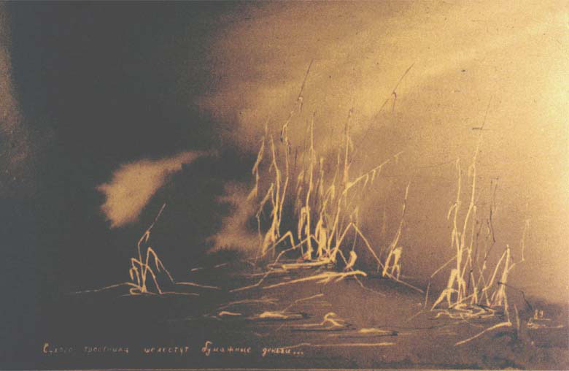
Thank you

